Slide 1
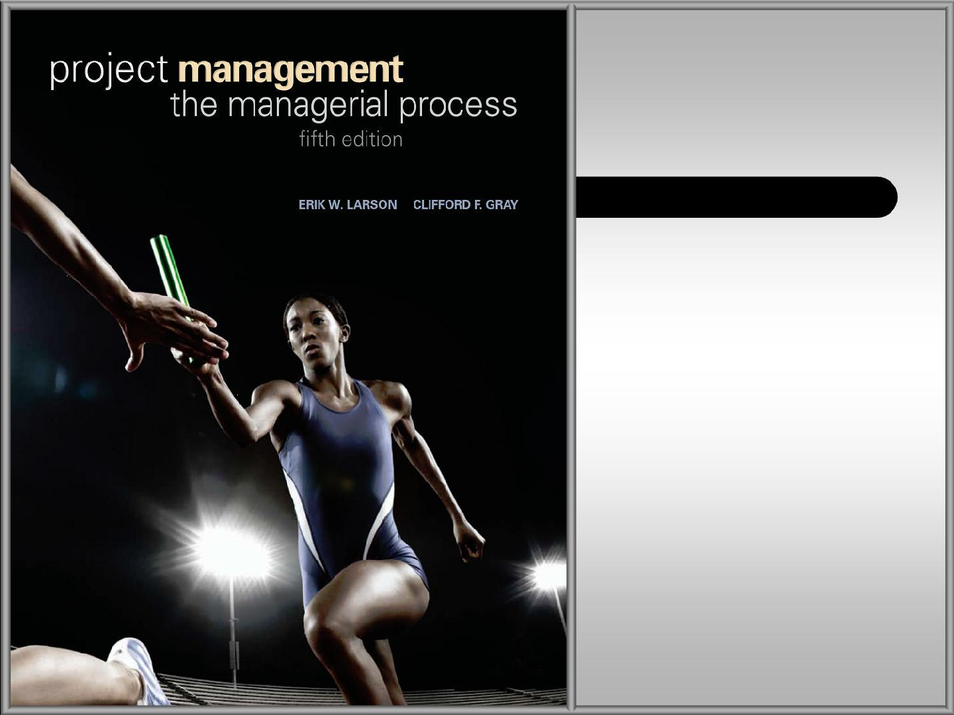
CHAPTER NINE
Reducing Project Duration
McGraw-Hill/Irwin
Copyright © 2011 by The McGraw-Hill Companies, Inc. All
rights reserved.

Slide 2

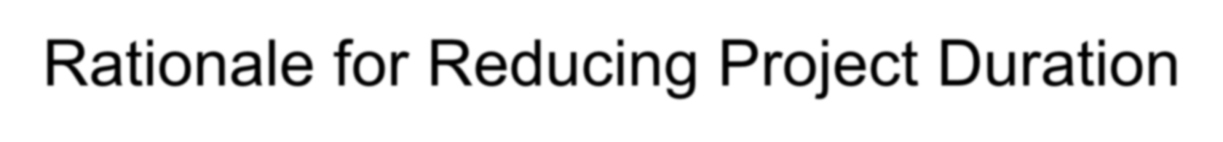
Rationale for Reducing Project Duration
Time Is Money: Cost-Time Tradeoffs
There are always cost-time trade-offs in project management.
You can completing a project early by hiring more workers or running extra shifts.
There are often penalties if projects extend beyond some specific date, and a
bonus may be provided for early completion.
Reducing the time of a critical activity usually incurs additional direct costs.
Cost-time solutions focus on reducing (crashing) activities on the critical path to shorten overall duration of the project.
–Reasons for imposed project duration dates:
Time-to-market pressures
Unforeseen delays
Incentive contracts (bonuses for early completion)
Imposed deadlines and contract commitments
Overhead and public goodwill costs
Pressure to move resources to other projects
9–2

Slide 3
Reducing- Crashing
Crashing a project means expediting some activities to reduce overall project completion time and total project costs.
Crashing an activity refers to taking special costly measures to reduce the duration of an activity below its normal value.
These special measures might include using overtime, hiring additional temporary help, using special time-saving materials, obtaining special equipment, etc.

Slide 4
Options for Accelerating Project Completion
Resources Not
Constrained
–Adding resources
–Outsourcing project work
–Scheduling overtime
–Establishing a core project team
–Do it twice—fast and then correctly
Resources Constrained
–Fast-tracking
–Critical-chain
–Reducing project scope
–Compromise quality
9–4

Slide 5
Project Costs
The total project costs are the sum of direct costs, indirect costs, and penalty costs.
Direct costs include labor, materials, and any other costs directly related to project activities.
Indirect costs include administration, depreciation, financial, and other variable overhead costs that can be avoided by reducing total project time.
The shorter the duration of the project, the lower the indirect costs will be.

Slide 6
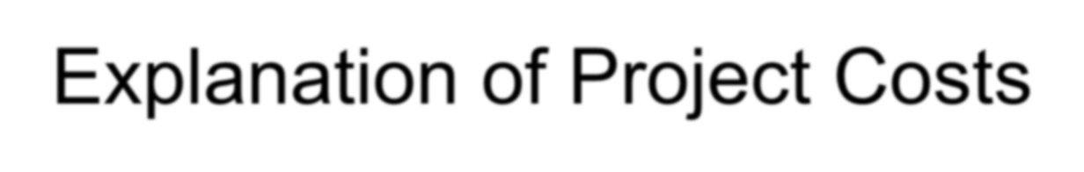
Explanation of Project Costs
Project Indirect Costs
–Costs that cannot be associated with any particular work package or project activity.
Supervision, administration, consultants, and interest
–Costs that vary (increase) with time.
Reducing project time directly reduces indirect costs.
Project Direct Costs
–Normal costs that can be assigned directly to a specific work package or project activity.
Labor, materials, equipment, and subcontractors
–Crashing activities increases direct costs.

Slide 7


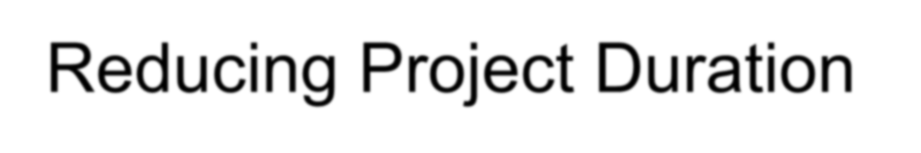
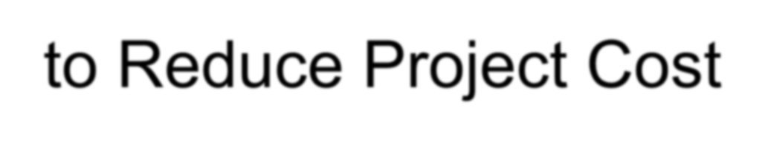



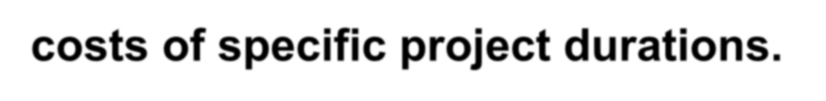




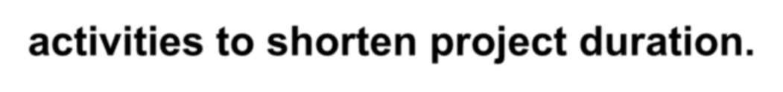


Reducing Project Duration to Reduce Project Cost
Identifying direct costs to reduce project time
Gather information about direct and indirect costs of specific project durations.
Search critical activities for lowest direct-cost activities to shorten project duration.
Compute total costs for specific durations and compare to benefits of reducing project time.

Slide 8
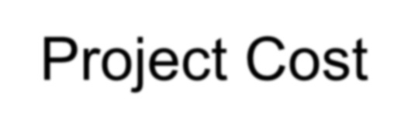
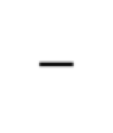
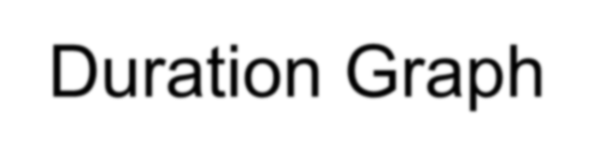
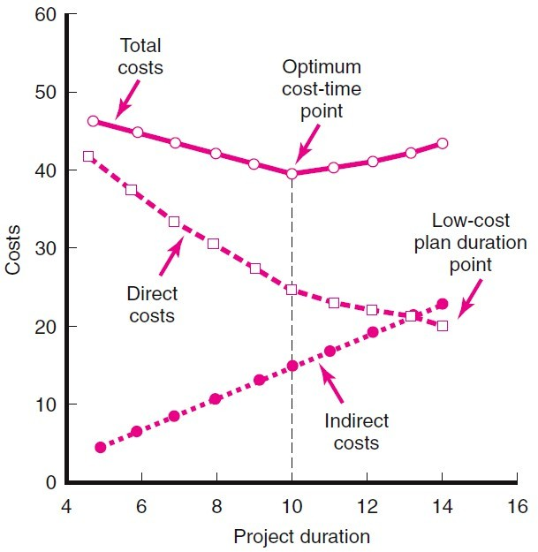
Project Cost–Duration Graph
FIGURE 9.1

Slide 9
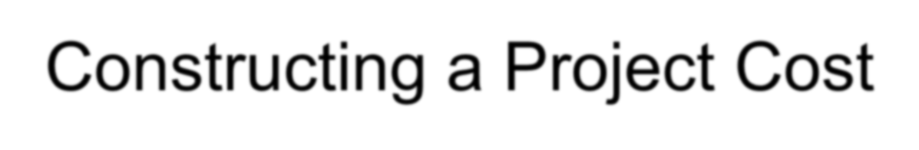
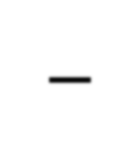
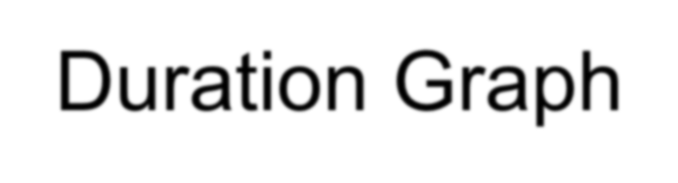



Constructing a Project Cost–Duration Graph
Find total direct costs for selected project durations.
Find total indirect costs for selected project durations.
Sum direct and indirect costs for these selected project durations.
Compare additional cost alternatives for benefits.

Slide 10
Constructing a Project Cost–Duration Graph
–Assumptions:
The cost relationship is linear.
Normal time assumes low-cost, efficient
methods to complete the activity.
Crash time represents a limit—the greatest time reduction possible under realistic conditions.
Slope represents a constant cost per unit of time.
All accelerations must occur within the normal and crash times.
Shorten the activities with the smallest increase in cost per unit of time.

Slide 11
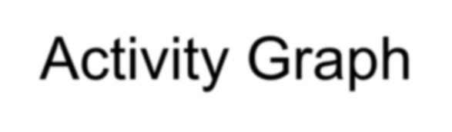
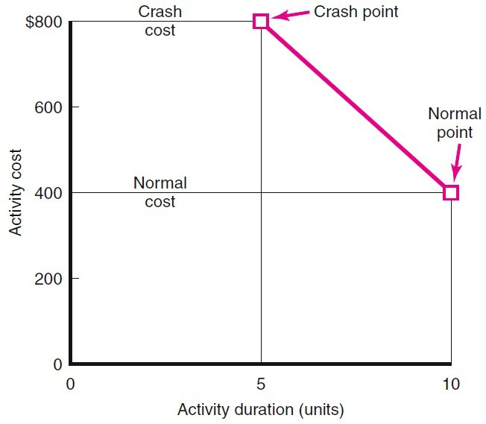
Activity Graph
FIGURE 9.2
9–10

Slide 12

Constructing a Project Cost–Duration Graph
To assess the benefit of crashing certain activities, either from a cost or a schedule perspective, the project manager needs to know the following times and costs.
Normal time (NT) is the time necessary to complete and activity under normal conditions.
Normal cost (NC) is the activity cost associated with the normal time.
Crash time (CT) is the shortest possible time to complete an activity.
Crash cost (CC) is the activity cost associated with the crash time.

Slide 13
Constructing a Project Cost–Duration Graph
Crash Cost − Normal Cost
The Cost to Crash per Period =
Normal Time − Crash Time
= SLOPE
CC − NC
The Cost to Crash per Period =
= SLOPE
NT − CT

Slide 14
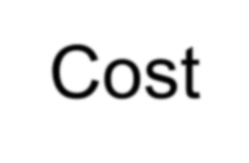
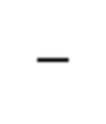
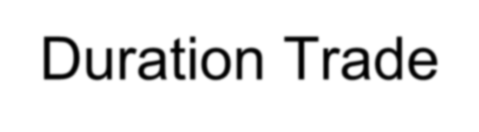
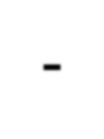
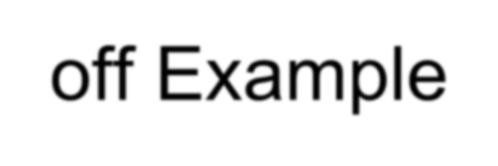
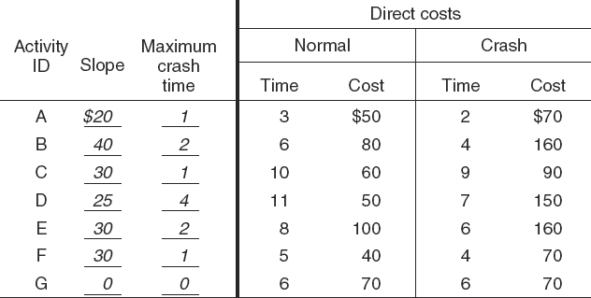
Cost–Duration Trade-off Example
FIGURE 9.3

Slide 15
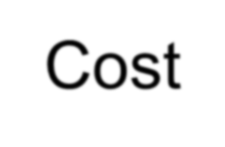
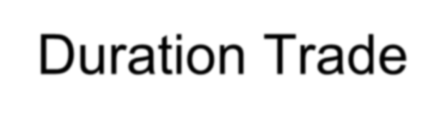
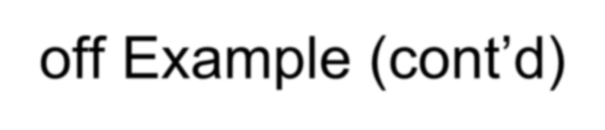
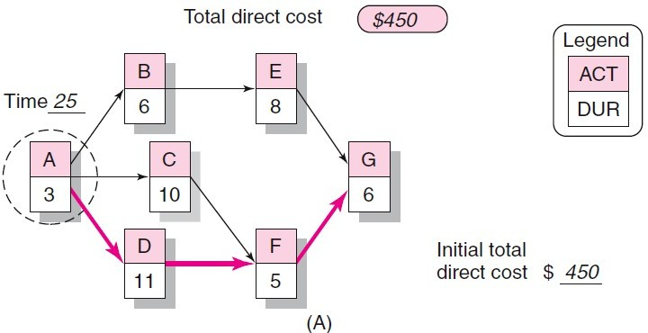
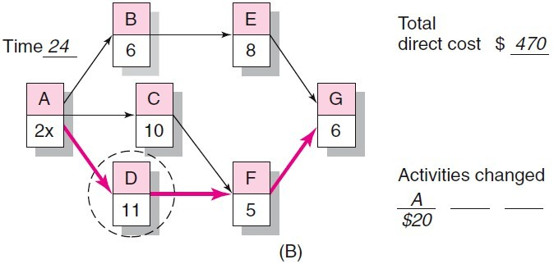
Cost–Duration Trade-off Example (cont’d)
FIGURE 9.3 (cont’d)

Slide 16
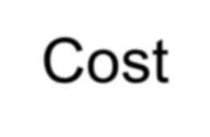
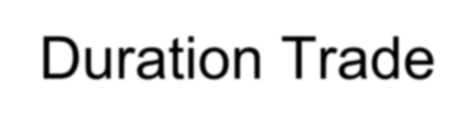
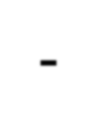
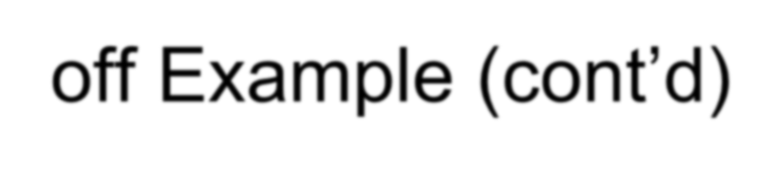
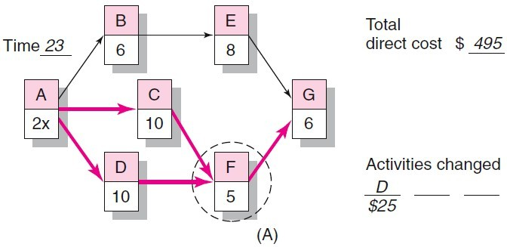
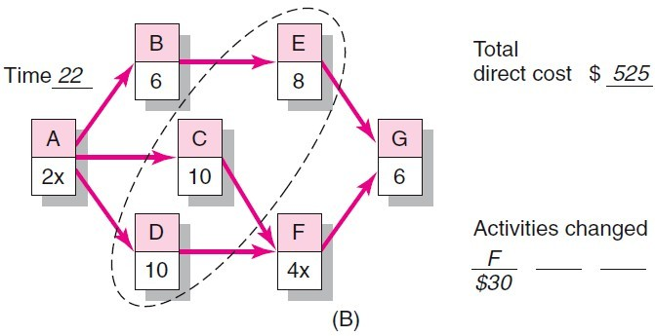
Cost–Duration Trade-off Example (cont’d)
FIGURE 9.4
9–13

Slide 17
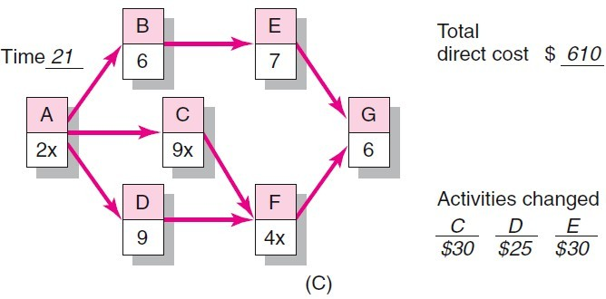
Cost–Duration Trade-off Example (cont’d)
FIGURE 9.4 (cont’d)
9–14

Slide 18
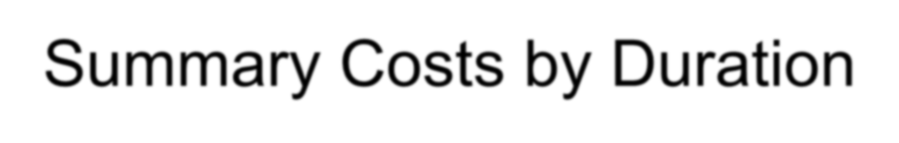
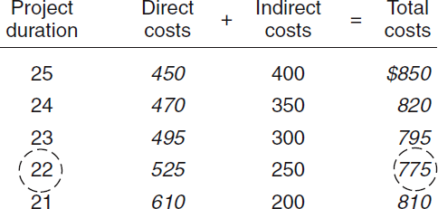
Summary Costs by Duration
FIGURE 9.5
9–15

Slide 19
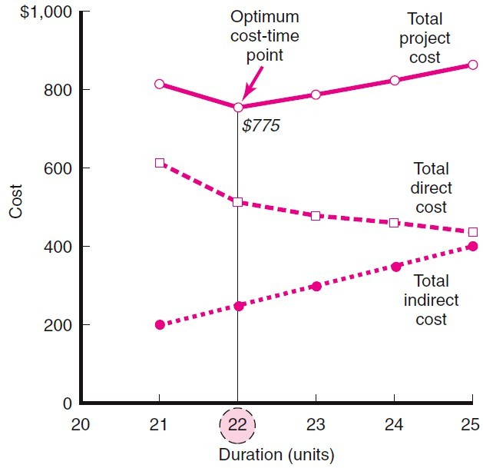
Project Cost–Duration Graph
FIGURE 9.6
9–16

Slide 20
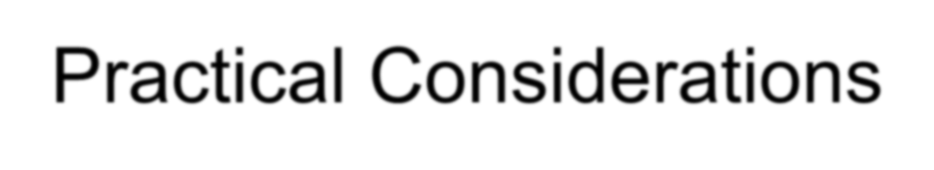
Practical Considerations
Using the Project Cost–Duration Graph
Crash Times
Linearity Assumption
Choice of Activities to Crash Revisited
Time Reduction Decisions and Sensitivity

Slide 21
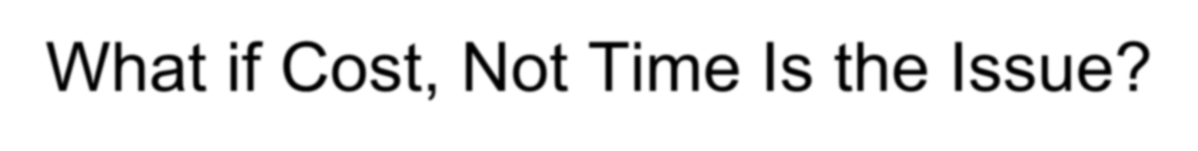
What if Cost, Not Time, Is the Issue?
Commonly Used Options for Cutting Costs
–Reduce project scope
–Have owner take on more responsibility
–Outsourcing project activities or even the entire project
–Brainstorming cost savings options

Slide 22
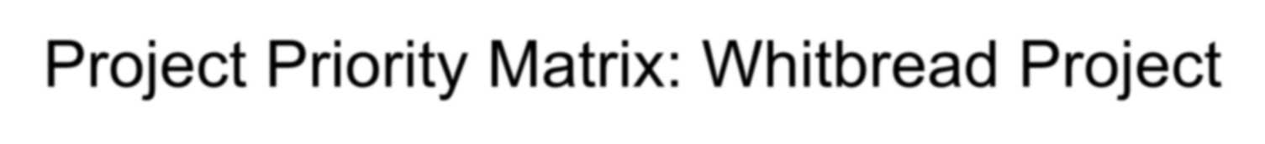
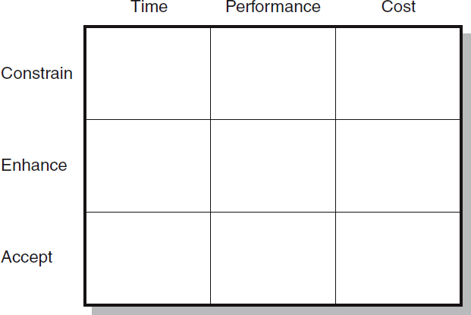
Project Priority Matrix: Whitbread Project
FIGURE 9.6

